Slide 1
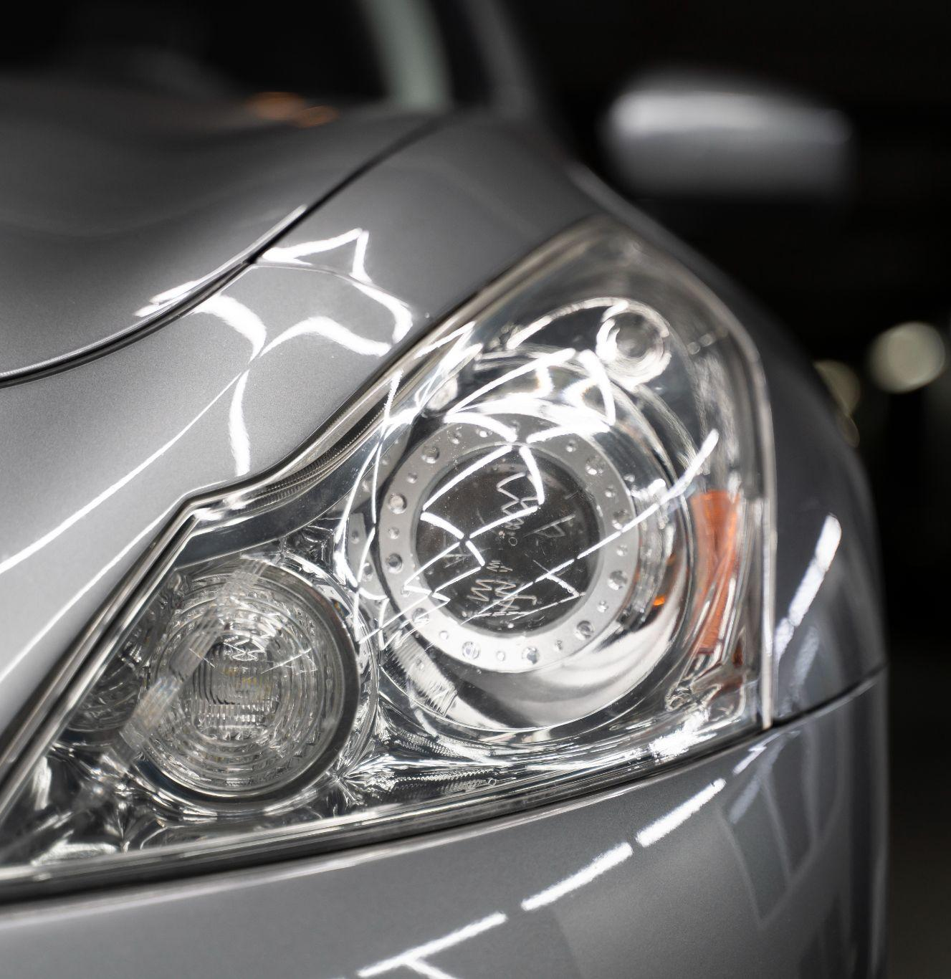

A Photo Journal showcasing the collection of cars

Slide 2
Our Aim
The Aim of CARGARAGE is to showcase that the cars are the works of art, symbols of freedom, and sources of inspiration.

Slide 3
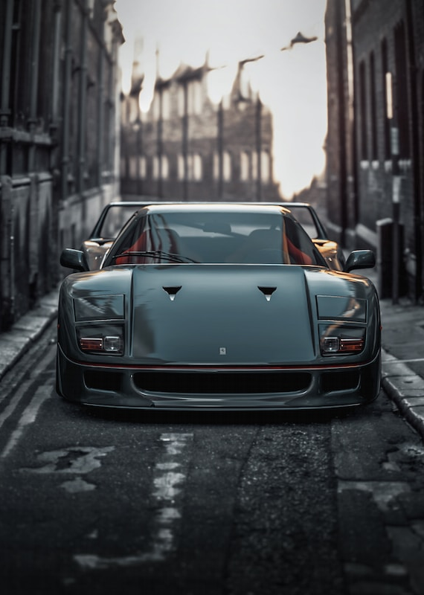
Our Objective
Our Objective is to make the Car Garage the place where everyone can share their thoughts about cars and where creative photographers can show their love for cars captured through the lens.

Slide 4
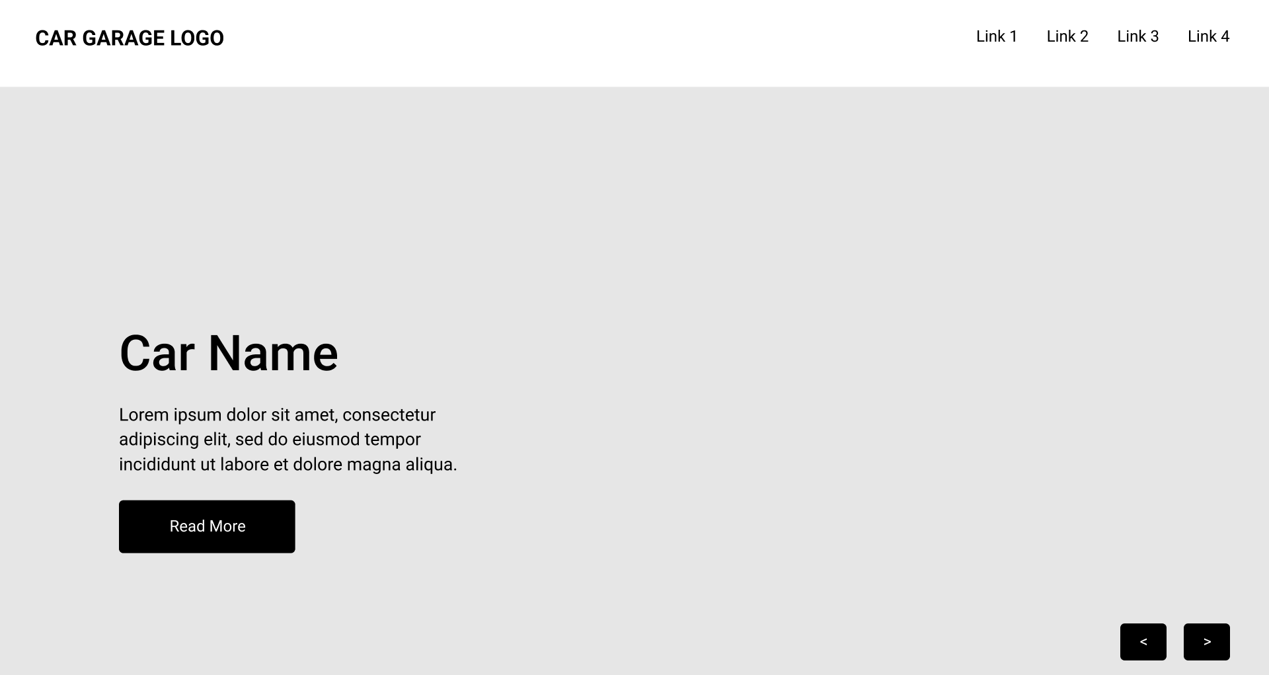
Mockup Design (Desktop)

Slide 5
Mockup Design (Mobile)

Slide 6
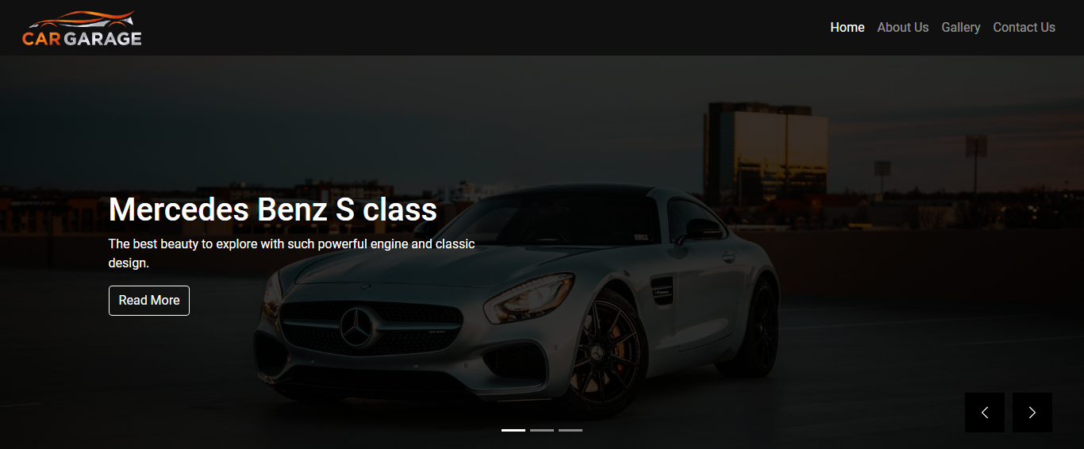
Responsiveness (Desktop)

Slide 7
Responsiveness (Mobile)

Slide 8




Front End Technology Used

Slide 9


Backend Technology Used

Slide 10
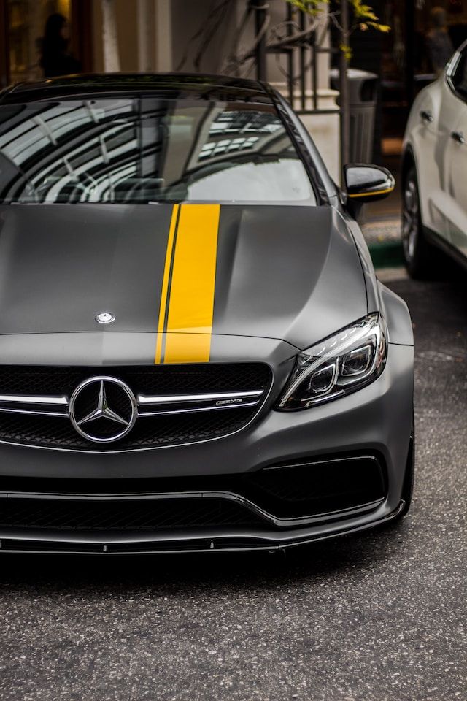
Problems and
Difficulties
Creating the branding like logo and colors
Creating the HTML Structure
Validating Form Inputs
Choosing right Images

Slide 11
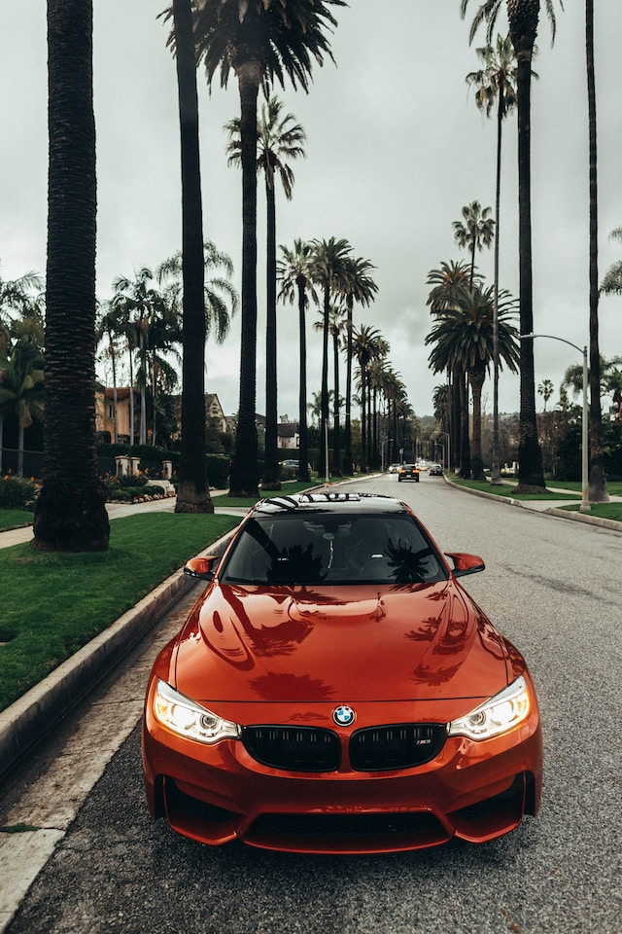
What Can be
Improved ?
User Registration system can be created to make users photos and comment.
More Section can be added in the website like Reviews
The gallery section can be improved in mobile

Slide 12
References
For Icons : https://www.flaticon.com/
For Lightbox modal : https://www.lightgalleryjs.com/
For Images : https://unsplash.com/
For JS animations: https://michalsnik.github.io/aos/
https://fontawesome.com/

Slide 13
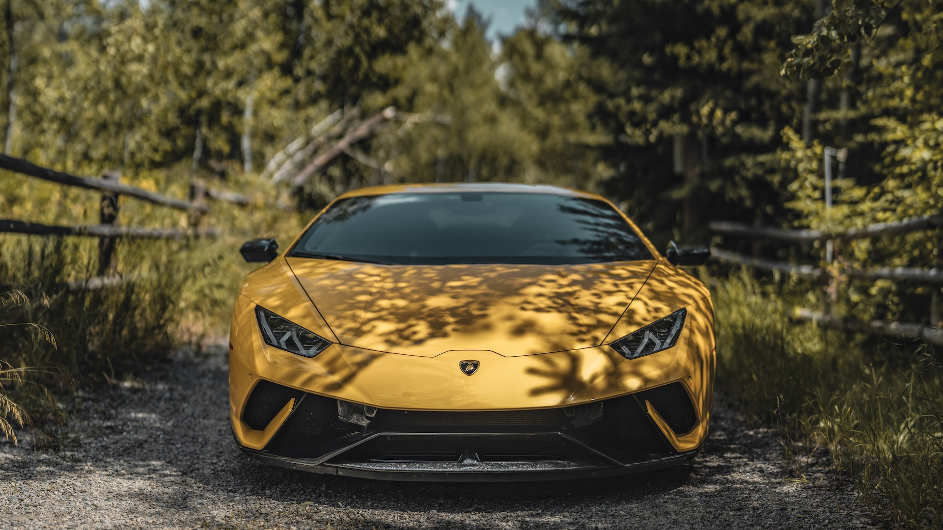
Any Questions?

